Slide 1
Intelligent in-vehicle Safety and Security Monitoring System
by
Xiaodi Fu
Chair: Dr. Jiang Lu, Ph.D.
Committee Member: Dr. Wei Wei, Ph.D.
Committee Member: Dr. Xiaokun Yang, Ph.D.

Slide 2
Outline
1
Introduction
Background
Application
Challenges
Contributions
4
Methods
Dataset Selection and Collection
Image Preprocessing
ResNet of feature extraction
Face classification on still images
Face classification on real-time videos
2
Related Work
Face Recognition
Face Detection
Face Alignment
Feature Extraction
Face Classification
5
Conclusion
6
Future Work
3
System Setup
Hardware Setup
Software Setup

Slide 3
1. Introduction

Slide 4
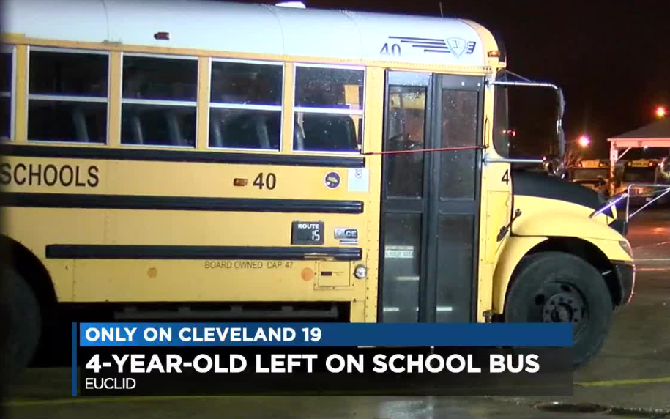
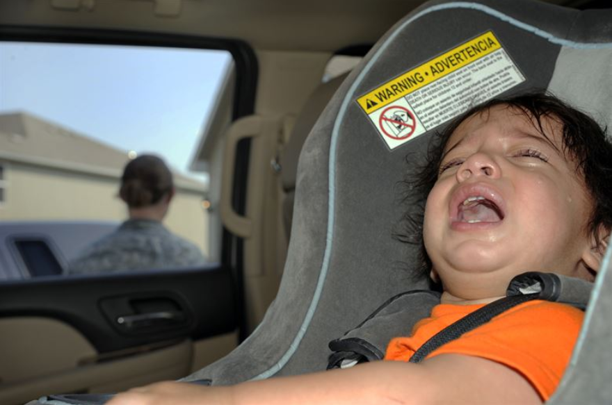
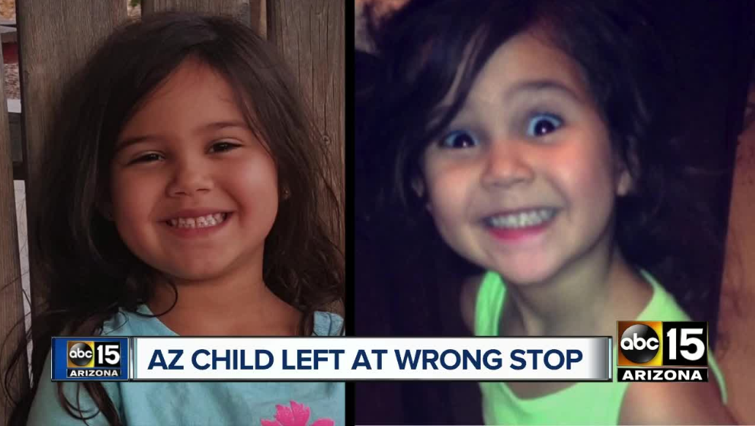
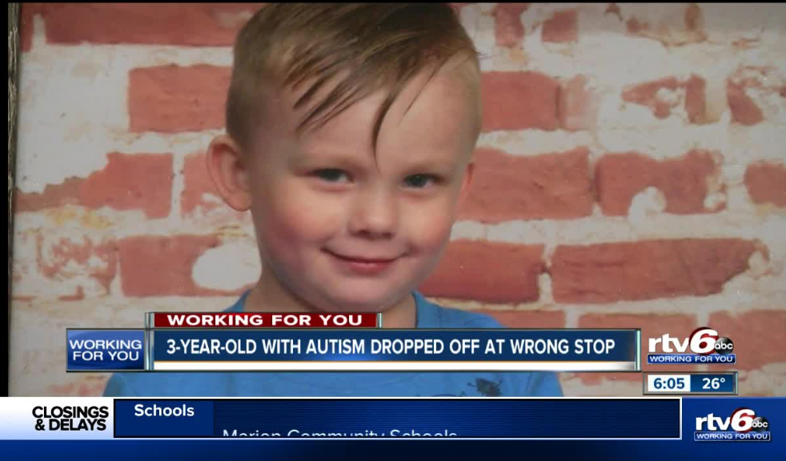
1 Introduction
Background
Children are left in school bus, dropped off at wrong bus stops.
Year | Number of Deaths (children)
2019- | 15
1998-2019 | 800
Strangers try to get on school bus.
a real-time intelligent in-vehicle monitoring system
Face recognition

Slide 5
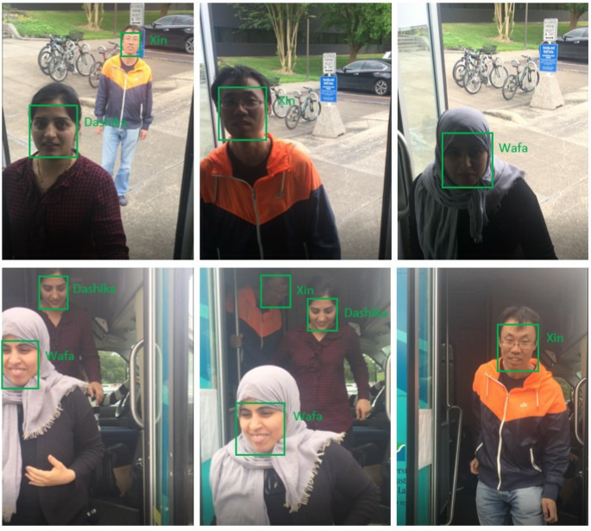
1 Introduction
Background
Sample frames of real-time face recognition when people get on and off a school bus

Slide 6
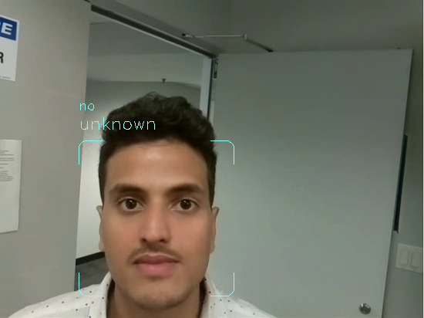
1 Introduction
Application
The system can be installed above the door of a school bus to monitor who get on or off the bus.
The system can give the driver safety tips when there are strangers.
The ResNet of facial feature extraction can be used as a tool for face recognition, face verification in mobile devices.

Slide 7
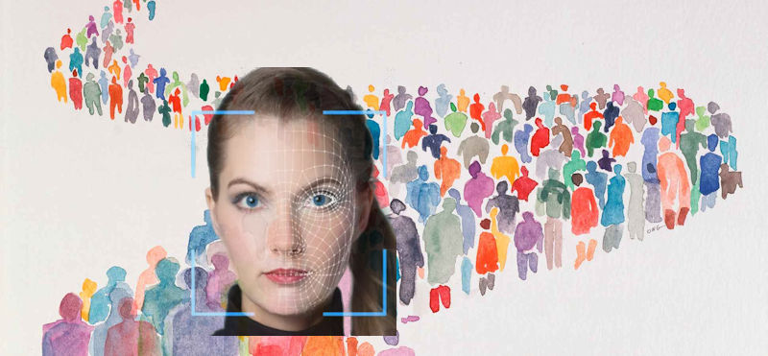
1 Introduction
Challenges
Design of ResNet;
Real-time processing videos;
Detection of strangers;
Data cleaning of the training dataset for ResNet;
Obtain multiple faces in a frame;
Align faces using facial landmarks;
Select classification algorithms;
Configure the distance sensor and motion sensor.

Slide 8
1 Introduction
Contributions
The system can launch the function of face recognition according to the distance between people and it and whether people is moving. Therefore, it can intelligently save energy and reduce work time.
The ResNet model can be used in some other mobile devices because it has the small number of parameters and it needs less time to extract facial features.

Slide 9
2. Related Work

Slide 10
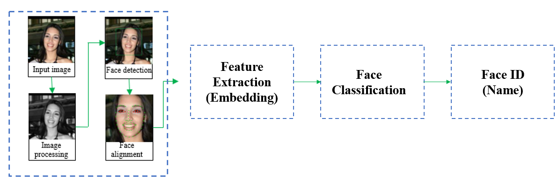
2 Related Work
Face Recognition
Workflow of face recognition

Slide 11
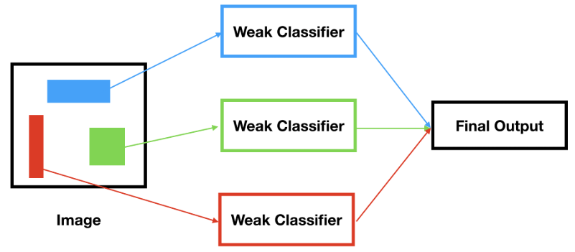
2 Related Work
Face Detection
Haar feature-based cascade detector in OpenCV (Viola-Jones algorithm);
Local Binary Patterns (LBP) cascade detector in OpenCV;
Deep Learning based detector in Dlib (based on CNN).
results from each classifier are combined, then they produce a strong classifier (cascade detector).

Slide 12
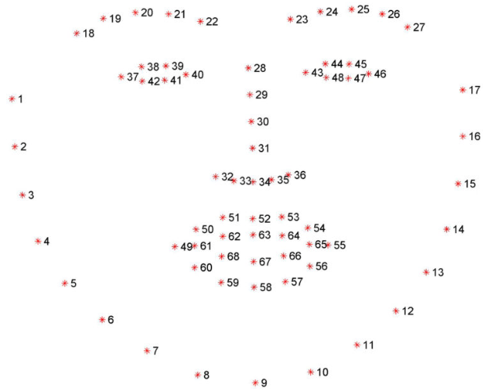
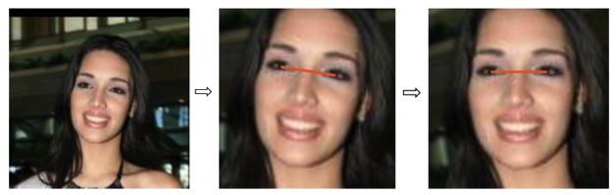
2 Related Work
Face Alignment
Obtain the geometric structure of each face by face landmarks;
Align faces by normalized rotation, scale, and translation.
Face alignment: from original image to an aligned face image.
The 68 face landmarks

Slide 13
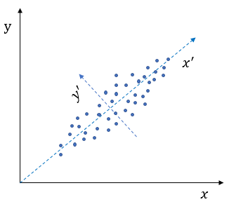
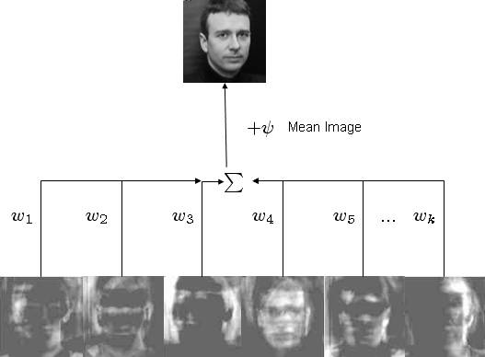
2 Related Work
Feature Extraction
Eigenfaces method
It projects face images onto a feature space in which each axis characterizes a significant variation among known face images. Important features are the eigenvectors of a set of faces. By projection operation, a face image is represented by a weighted sum of the eigenfaces (eigenvectors).
$$a face=mean face+ w_{1}∗eigenface1+w_{2}∗eigenface2+…+w_{k}∗eigenfacek$$
The principal components of two-dimensional data

Slide 14
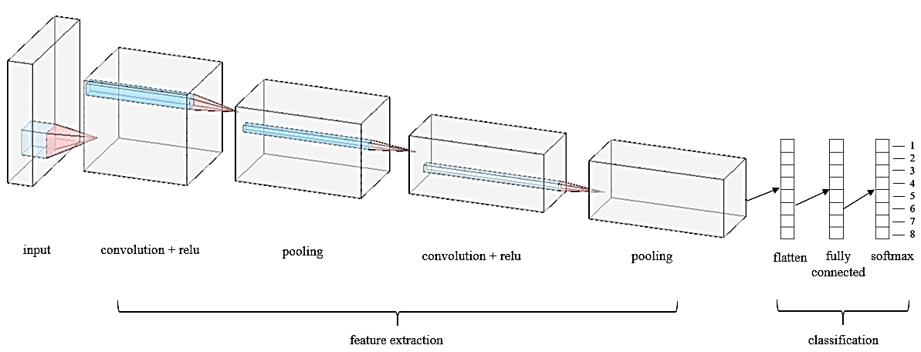
2 Related Work
Feature Extraction
Method based on deep convolutional network
In 2012, AlexNet wins ImageNet Large Scale Visual Recognition competition (ILSVRC) which is an image classification competition. The AlexNet is a CNN which is proved to be very effective in image recognition.

Slide 15
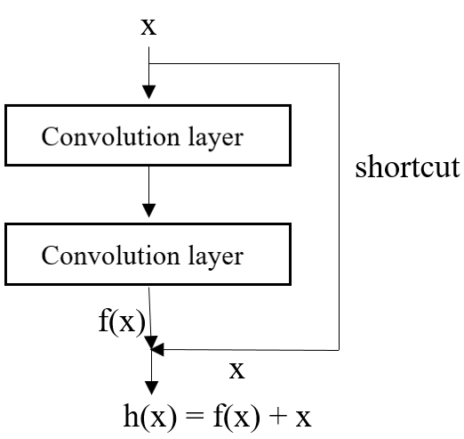
2 Related Work
Feature Extraction
Method based on deep residual network (ResNet)
Kaiming He et al. presented deep residual network which won the first place in ILSVRC (ImageNet Large Scale Visual Recognition Competition) and COCO (Common Objects in Context) 2015 competition in all five main tracks. ResNet can largely overcome degradation in deep learning and ease training in neural network.
x is an input.
h(x) is objective function.
Traditional CNN: x h(x)
ResNet: x + f(x) h(x)
a block in a ResNet

Slide 16
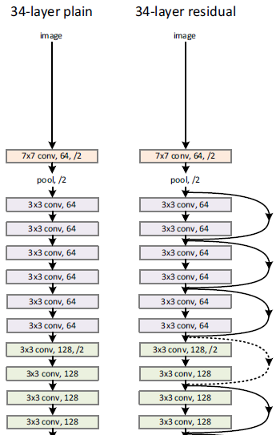
2 Related Work
Feature Extraction
A segment of architectures for a ResNet

Slide 17
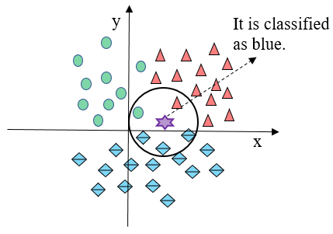
2 Related Work
Face Classification
k-nearest neighbors’ classifier (kNN)
It assumes that similar data points exist in proximity. It is similar with the proverb that birds of a feather flock together. Neighbors votes the point.
How data point is classified using kNN algorithm

Slide 18
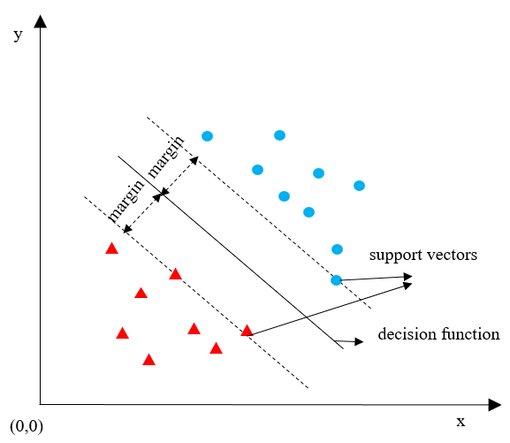
2 Related Work
Face Classification
Support Vector Machine (SVM)
SVM separates the training data into different categories by locating a decision function. The decision function is selected according to its distance to the nearest data point in each categories. It maximizes its distance to the nearest data point in each categories.
How data point is classified by using SVM algorithm

Slide 19
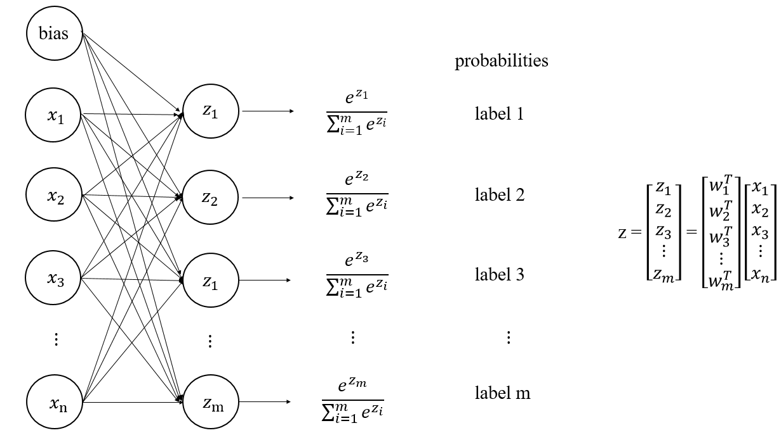
2 Related Work
Face Classification
Softmax classifier
It is often used in multiple classification and uses cross-entropy loss function. If you classify a data point, it gives you probabilities for every class label.
Multi-class classification using softmax classifier

Slide 20
3. System Setup

Slide 21
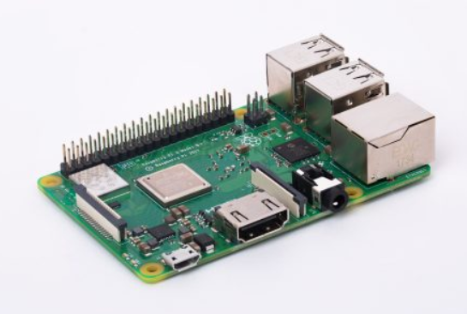
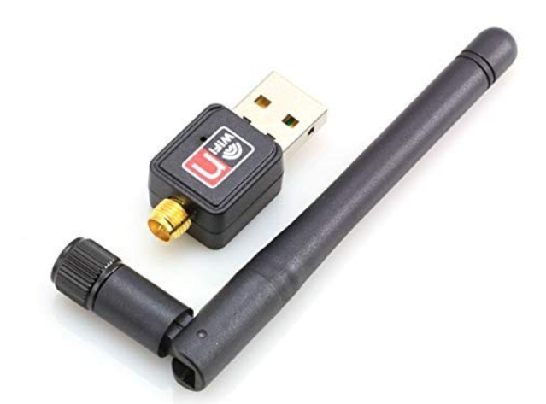
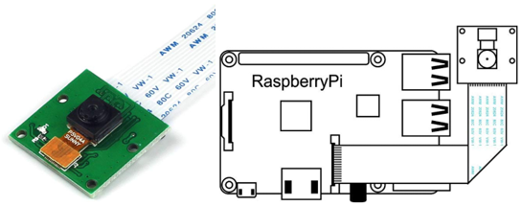
3 System Setup
Hardware Setup
Raspberry Pi
Camera module
Wireless adapter

Slide 22
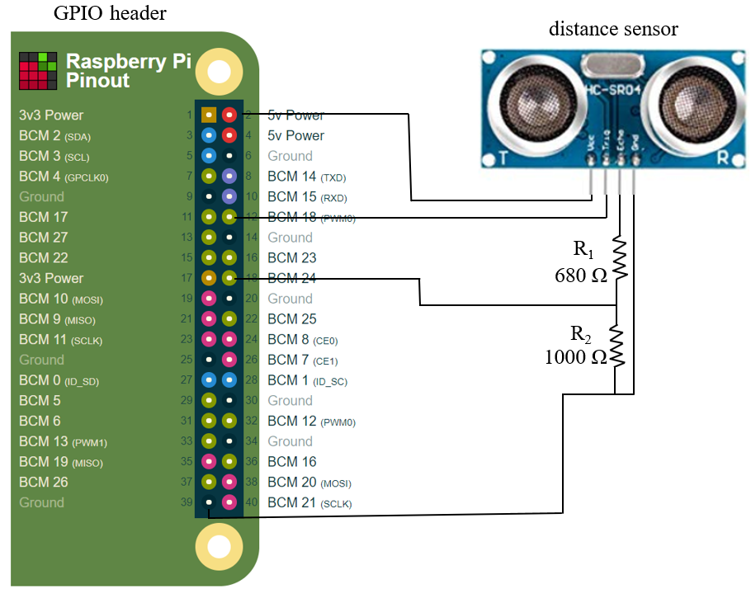
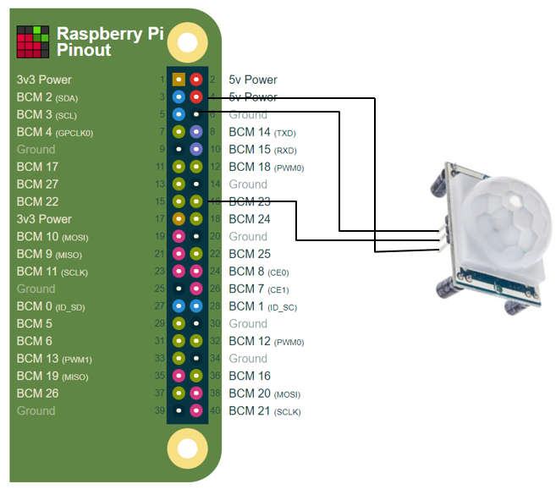
3 System Setup
Hardware Setup
Connection of a distance sensor and Raspberry Pi
Connection of a motion sensor and Raspberry Pi

Slide 23
3 System Setup
Hardware Setup
Specification of a distance sensor
model | HC-SR04
working voltage | 5V DC
resolution | 0.3 cm
frequency | 40 kHz
range | 2cm – 300cm
dimension | 45 mm ×20 mm ×15mm
Specification of a motion sensor
model | HC-SR501
working voltage | 4.5 – 20V DC
delay time | 0.3 – 200s
board dimension | 32 mm × 24 mm

Slide 24

3 System Setup
Software Setup
TensorFlow
Developed by Google Brain team
An ecosystem for developing deep learning models
Keras
A high-level library
Friendly implementation and fast prototyping
Scikit-learn
Efficient tool for machine learning
Many algorithms implemented in classification, clustering
OpenCV
Has more than 2500 optimized algorithms
An open source computer vision library

Slide 25
3 System Setup
Software Setup
Dlib
Contains many machine learning algorithms to solve problems in domains of robotics, mobile phones, embedded devices
An open source library
NumPy
A fundamental package in Python
Includes computation of multi-dimensional array and matrices, complex linear algebra, Fourier transformation and so on
Imutils
A library of image processing
Contains functions of rotation, affine transformation, resizing, translation

Slide 26
4. Methods

Slide 27
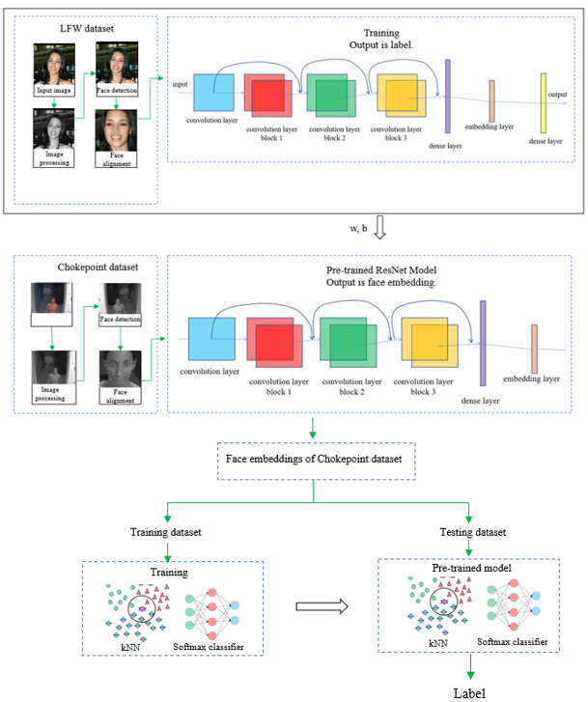
Workflow of my work
4 Methods
Make the tool of facial feature extraction
Use the tool of facial feature extraction
Face classification

Slide 28
4 Methods
Dataset Selection and Collection
Three dataset
标题文本预设
LFW dataset
Chokepoint dataset
Delta dataset
Consists of 25 people
A video dataset (30 fps)
People walking through a portal
Download from website
Used for face classification
13233 images and 1680 people
A digital image dataset
Download from website
Used for training ResNet
Consists of 4 people
A digital dataset
People in our lab
Collected by ourselves
Used for face classification

Slide 29

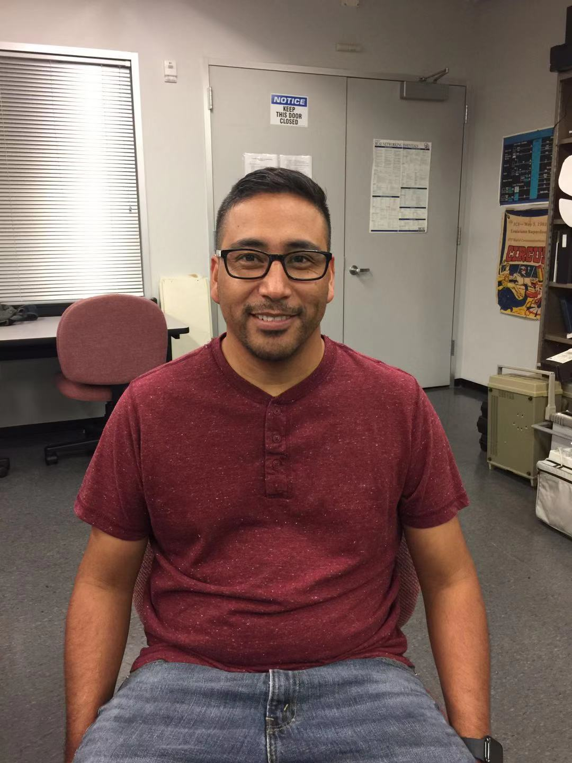
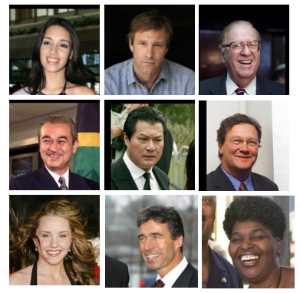
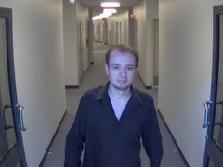
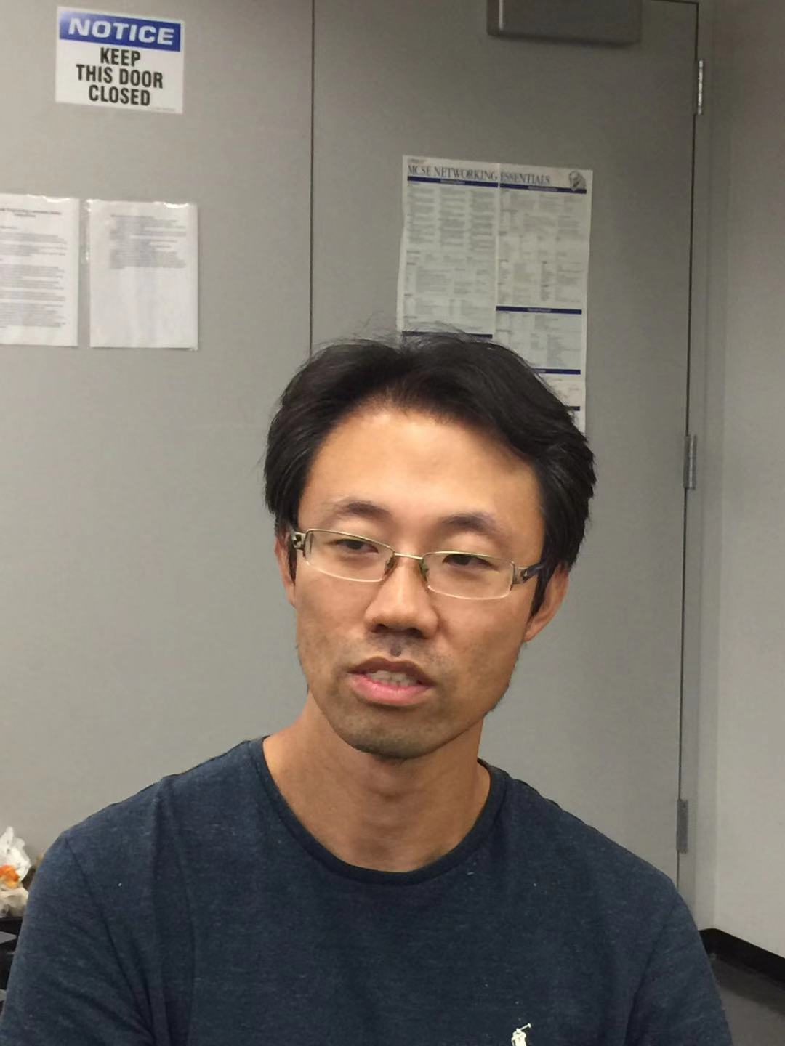
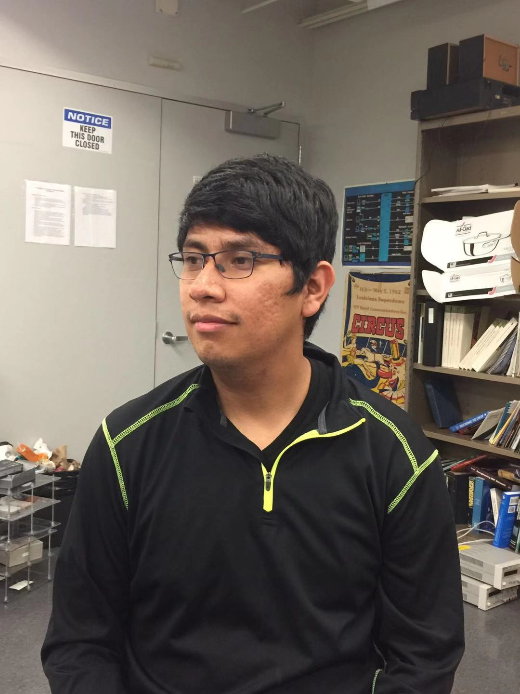
4 Methods
Dataset Selection and Collection
LFW dataset
Chokepoint dataset
Delta dataset

Slide 30
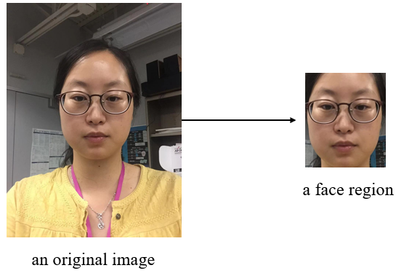
4 Methods
Image Preprocessing
Color to grayscale conversion
Face cropping
Face alignment
An example of face cropping in preprocessing images

Slide 31
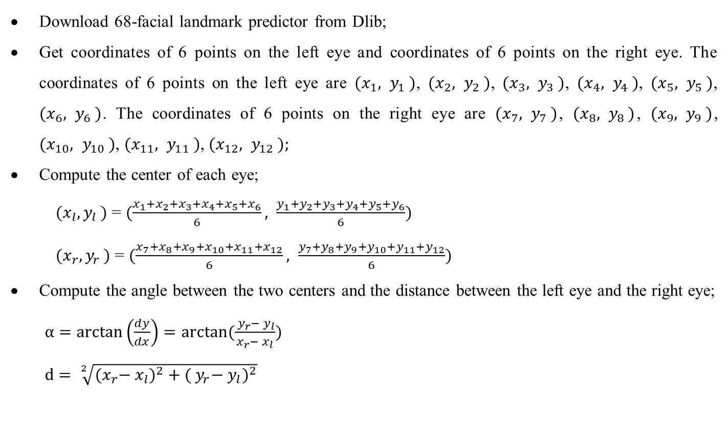
4 Methods
Image Preprocessing
Steps of face alignment are as follows
Download 68-facial landmark predictor from Dlib;
Get coordinates of 6 points on the left eye and coordinates of 6 points on the right eye. The coordinates of 6 points on the left eye are ${(x}_{1}{, y}_{1})$, ${(x}_{2}{, y}_{2})$, ${(x}_{3}{, y}_{3})$, ${(x}_{4}{, y}_{4})$, ${(x}_{5}{, y}_{5})$, ${(x}_{6}{, y}_{6})$. The coordinates of 6 points on the right eye are ${(x}_{7}{, y}_{7})$, ${(x}_{8}{, y}_{8})$, ${(x}_{9}{, y}_{9})$, ${(x}_{10}{, y}_{10})$, ${(x}_{11}{, y}_{11})$, ${(x}_{12}{, y}_{12});$
Compute the center of each eye;
${ (x}_{l}{, y}_{l})$ = $(\frac{x_{1}+x_{2}+x_{3}+x_{4}+x_{5}+x_{6}}{6}, \frac{y_{1}+y_{2}+y_{3}+y_{4}+y_{5}+y_{6}}{6})$
${ (x}_{r}{, y}_{r})$ = $(\frac{x_{7}+x_{8}+x_{9}+x_{10}+x_{11}+x_{12}}{6}, \frac{y_{7}+y_{8}+y_{9}+y_{10}+y_{11}+y_{12}}{6})$
Compute the angle between the two centers and the distance between the left eye and the right eye;
$α=\arctan\left(\frac{dy}{dx}\right)=arctan(\frac{{{ y}_{r}− y}_{l}}{x_{r}− x_{l}})$
$d= \sqrt[2]{{{(x}_{r}− x_{l})}^{2}+{({{ y}_{r}− y}_{l})}^{2}}$

Slide 32
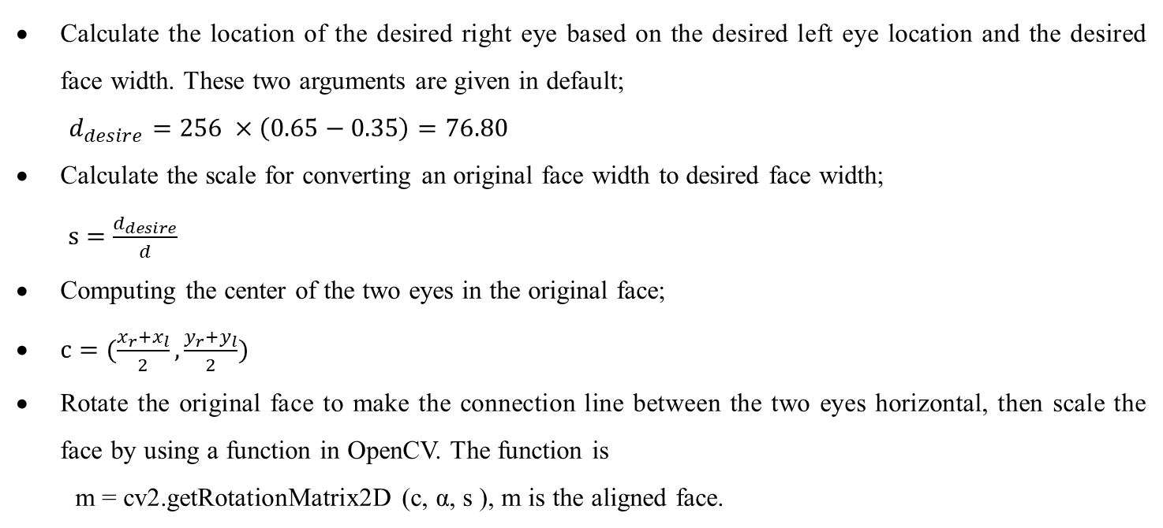
4 Methods
Image Preprocessing
Calculate the location of the desired right eye based on the desired left eye location and the desired face width. These two arguments are given in default;
$d_{desire}=256 ×\left(0.65−0.35\right)=76.80$
Calculate the scale for converting an original face width to desired face width;
$s=\frac{d_{desire}}{d}$
Computing the center of the two eyes in the original face;
$c=(\frac{x_{r}+x_{l}}{2}, \frac{y_{r}+y_{l}}{2})$
Rotate the original face to make the connection line between the two eyes horizontal, then scale the face by using a function in OpenCV. The function is
m = cv2.getRotationMatrix2D (c, α, s ), m is the aligned face.

Slide 33
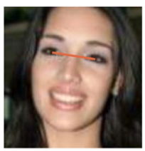
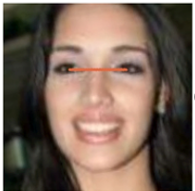
4 Methods
Image Preprocessing
α
Original face
Horizontal line
Aligned face
c

Slide 34
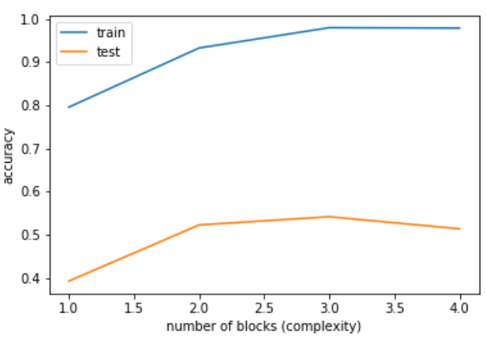
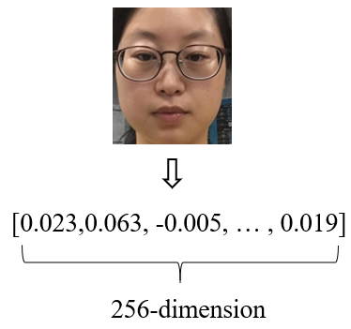
4 Methods
ResNet of feature extraction
Design the number of blocks
Design dimension of face embedding
512-dimensional embedding and 256-dimensional embedding, the test accuracy is 71.50% and 72.06%, respectively. The 256-dimensional embedding is selected
The accuracy of ResNet with different number of blocks

Slide 35
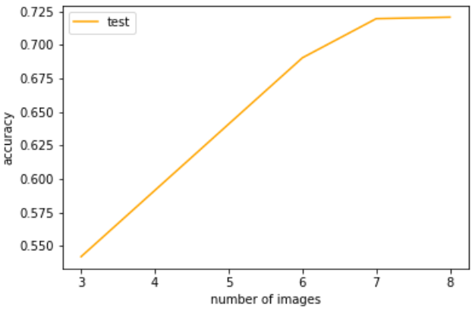
4 Methods
ResNet of feature extraction
We trained the model using a subset of LFW. Each person has 7 or more images in the subset. Every people with less than 7 images in LFW is not trained.
Adam optimizer with learning rate 0.001 and cross-entropy loss. Kernel initializer is set as “He normal”.
Testing accuracy with different number of images for one person

Slide 36
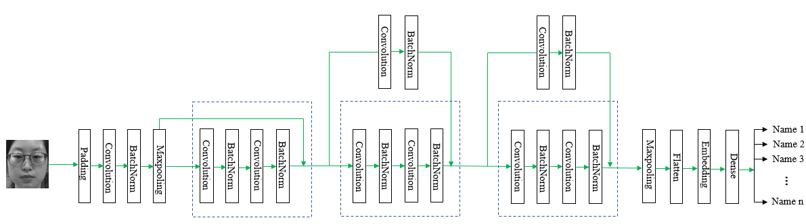
4 Methods
ResNet of feature extraction
Architecture of the ResNet

Slide 37
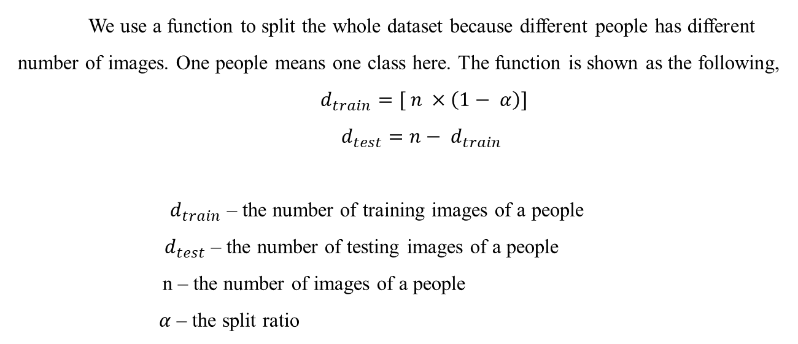
4 Methods
ResNet of feature extraction
Training the ResNet
We use a function to split the whole dataset because different people has different number of images. One people means one class here. The function is shown as the following,
$d_{train}=[ n ×\left(1− α\right)]$
$d_{test}=n− d_{train}$
$d_{train}$ – the number of training images of a people
$d_{test}$ – the number of testing images of a people
n – the number of images of a people
$α$ – the split ratio
the split ratio is 0.05.
total 4822 images belonging to 217 classes. The training dataset contains 4482 images and the testing dataset has 340 images.

Slide 38
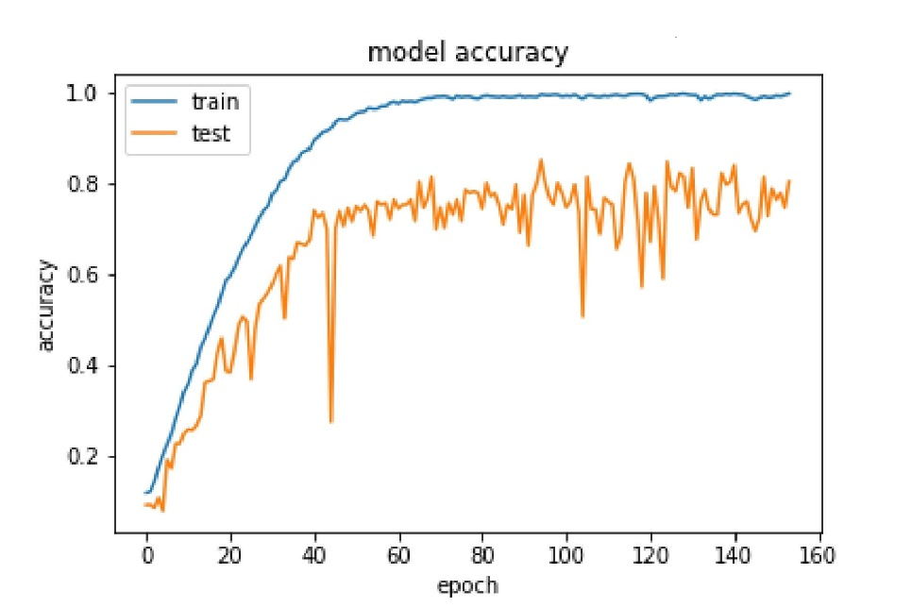
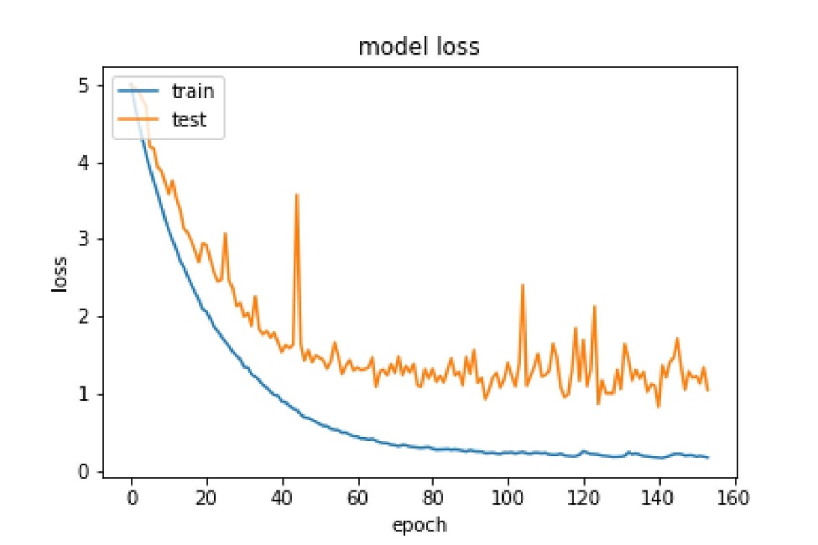
4 Methods
ResNet of feature extraction
Training the ResNet
Accuracy of the ResNet with 3 blocks
Loss of the ResNet with 3 blocks

Slide 39
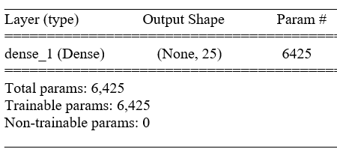
4 Methods
Face classification on still images
Chokepoint dataset
kNN model
softmax classifier
The number of neighbors is 5.
standard Euclidean metric.
The accuracy is 93%.
The accuracy is 87%.

Slide 40
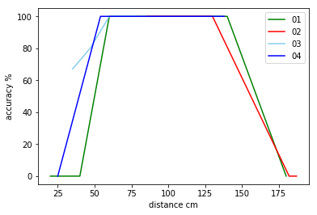
4 Methods
Face classification on real-time videos
The Delta dataset is used to train a classification model – kNN. The dataset contains 4 people. Those 4 are labelled as 01, 02, 03 and 04. Then the trained model can classify people when they appear in Pi camera.
No. | 01 | 02 | 03 | 04
Total frames | 33 | 47 | 46 | 59
Frames of detecting faces | 8 | 23 | 6 | 10
Frames of correct classification | 5 | 21 | 6 | 9
Frames of false classification | 3 | 2 | 0 | 1
Classification accuracy | 75% | 91% | 100% | 93%
Detection rate | 24% | 49% | 13% | 17%
No distance setting and motion setting
The relation between distance and accuracy without setting distance and motion

Slide 41
4 Methods
Face classification on real-time videos
No. | 01 | 02 | 03 | 04
Total frames | 30 | 30 | 30 | 30
Frames of detecting faces | 24 | 20 | 21 | 19
Frames of correct classification | 23 | 18 | 19 | 19
Frames of false classification | 1 | 2 | 2 | 0
Classification accuracy | 96% | 90% | 95% | 100%
Detection rate | 80% | 67% | 70% | 63%
No. | 01 | 02 | 03 | 04
Total frames | 30 | 30 | 30 | 30
Frames of detecting faces | 4 | 6 | 4 | 3
Frames of correct classification | 4 | 1 | 4 | 3
Frames of false classification | 0 | 0 | 0 | 0
Classification accuracy | 100% | 83% | 100% | 100%
Detection rate | 13% | 20% | 13% | 10%
Results when distance is equal to or less than 100 cm and no motion setting
Results when distance is equal to or less than 100 cm and motion is set as True

Slide 42
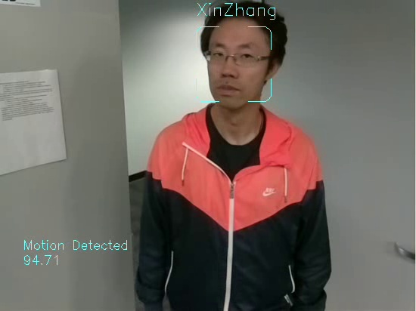
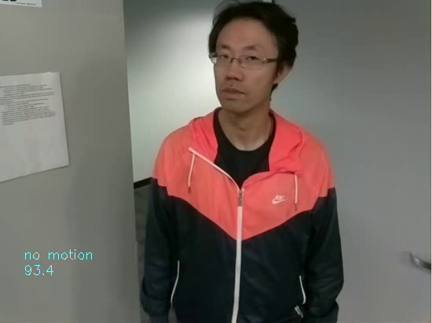
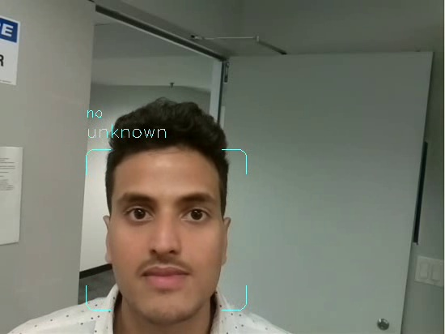
4 Methods
Face classification on real-time videos
Face recognition when distance is less than 100cm and motion is detected
No face recognition when distance is less than 100cm and no motion is detected
An “unknown” person detected by the system

Slide 43
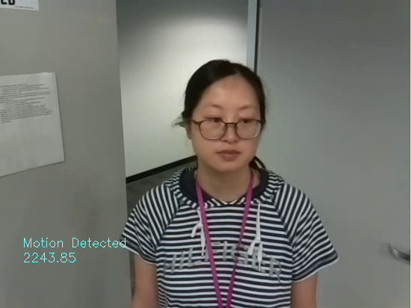

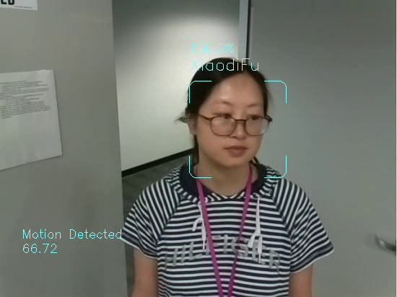
4 Methods
Face classification on real-time videos
3 continuous frame
Face recognition when distance is less than 100cm and motion is detected

Slide 44
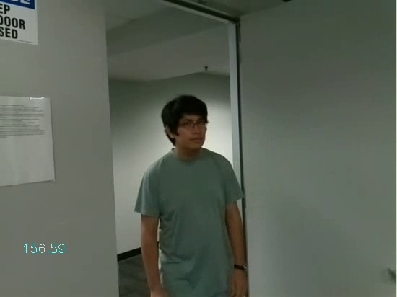


4 Methods
Face classification on real-time videos
3 continuous frame
Face recognition with no distance setting and motion setting

Slide 45
5. Conclusion

Slide 46
5 Conclusion
We designed a ResNet with relatively small number of parameters (573,752) to extract face features;
The ResNet model with 3 blocks performs better than models with 4 and 2 blocks;
By experiments of kNN and softmax classifier, the accuracy of kNN is 93% and the softmax classifier is 87% on recognizing 25 people;
In real-time face recognition, distance sensor performs good when people appear 100cm in the front of the system;
If distance between people and the system is bigger than 120 cm, the accuracy largely decreases and even it cannot detect people;
Motion sensors limit conditions of the system. Therefore, it should be installed according special conditions.

Slide 47
5 Future work
The ResNet needs to be optimized because overfitting exists;
The threshold for detecting strangers needs to tune according to different conditions. Looking for a better way to set the threshold;
The accuracy of face recognition should be improved.
A people recognized in one frame may not mean that he is recognized. It needs a sequence of frames to ensure that he appears in a video.

Slide 48
Publications
Title | Publisher | Date/Status
Intelligent In-vehicle Safety and Security Monitoring System with Face Recognition | The 22nd IEEE International Conference on Computational Science and Engineering | 2019, accepted for publication
Intelligent In-vehicle Safety and Security Monitoring System | Dual Conference on Innovation/Automation | 2018

Slide 49


demo
Face recognition when distance <= 100 cm
Face recognition with no distance setting

Slide 50


demo
Face recognition with no distance setting
Face recognition with distance setting and motion setting

Slide 51

demo
Face recognition with no distance setting

Slide 52

THANK YOU ！

